Slide 1

205SE Programming for Engineers
Tutorial 3
Grains of Rice on a Chessboard

Slide 2
Last Week
Variable definition
does what 3 things?
Using the cin object
Variables and scope
why do we have different levels of scope?
Global and local variables
why do we prefer local variables?
if selection statement
Boolean expressions
evaluates to?

Slide 3

Objectives for Today
Repetition/loop statements
while loop
Grains of Rice on a Chessboard!
int (limits of storage space)
double
Increment operator ++
do… while loop
char

Slide 4
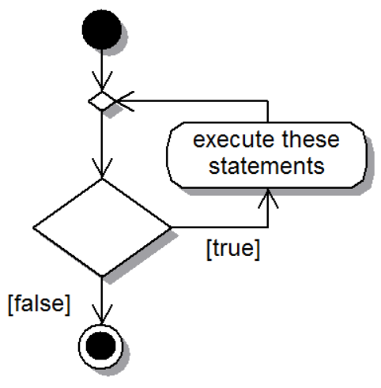
Repetition statement – while loop
while(true)
{
// execute
// these
// statements
// and loop
}

Slide 5

Starting the Tutorial Work
If on a new PC, clone your remote source repository from last time:
https://github.coventry.ac.uk/205SE-1920SEPJAN /<your username>-tutorialwork
Open the cloned repo in Visual Studio
Create a new solution ‘T3-GrainsOfRice’
Commit changes
Push commits to remote
Begin working on Activity 1

Slide 6

Activity 1 – while loop
We can use the ++ operator to increment by 1
Write a program which calculates the sum of integers from 1 to 10 using a while loop and outputs the results at every iteration
(Deitel Ch04 Ex05)
What variables do we need to store?
int sum;
int counter;

Slide 7

Activity 2 – Grains of Rice on a Chessboard!
The tale, as it goes… The king decides to reward the inventor of chess…
For a reward, the creator of chess simply asks for 1 grain of rice for the first square on the chessboard, 2 for the following square, 4 for the following square… and so on every day for the full 64 squares on the board
The king promises to pay the reward…

Slide 8
Activity 2 – Grains of Rice on a Chessboard!
The console output should look like this…
Day 1: 1 rice today, 1 total rice so far!
Day 2: 2 rice today, 3 total rice so far!
Day 3: 4 rice today, 7 total rice so far!
Day 4: 8 rice today, 15 total rice so far!
…
How many grains of rice does the king pay?
Let’s use a while loop to calculate it!

Slide 9
Activity 2 – Grains of Rice on a Chessboard!
What variables do we need to store?
day
riceToday
totalRice
What are the events that we need to do?
while the day is less than 64:
Increment the day
Double riceToday
Calculate totalRice
Output the day
Output the riceToday
Calculate and output the totalRice
What order do the events happen in?
What values should we initialise the variables to?

Slide 10
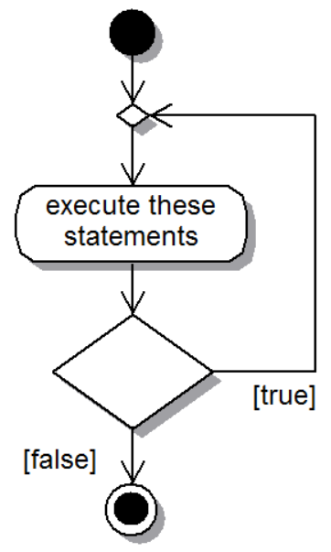
Repetition statement – do… while loop
do
{
// execute
// these
// statements
// at least once
}
while(true);

Slide 11
Comparing
while loop:
do… while loop:
Condition first…
Execute at least once
Condition after…

Slide 12
Activity 3
Use a do... while loop to ask the user to enter ‘y’ then check the user’s input before continuing with your program.
Check for either a ‘y’ or a ‘Y’
Hint: We must use the primitive data type of char to store the input from the user
Single quotes can be used for specifying a char literal e.g. ‘e’

Slide 13

CodinGame Activity 4
Break into mini competition groups (desk of 6?)
With everyone on your desk/group starting at the same time, (wait/help the rest of the group to complete the previous task first), see who can solve the following CodinGame puzzle first:
The Descent:
https://www.codingame.com/training/easy/the-descent
(You will need to sign up for an account with them or use your google account etc.)
It has its own web browser based IDE

Slide 14
More… with while loops
‘Deitel Exercises 4.05 to 4.22’ on Moodle
while loops

Slide 15

Homework 1 – While user is gullible
Write a program that continues to ask the user to enter any number other than 5, until the user enters the number 5.
Then tell the user "Hey! you weren't supposed to enter 5!" and exit the program.
Easy ★ Modify the program so that after 10 iterations if the user still has not entered 5 output "Wow, you're more patient then I am, you win." and exit.
Hard ★★ Modify the program so that it asks the user to enter any number other than the number equal to the number of times they have been asked to enter a number. (i.e. on the first iteration: "Please enter any number other than 0“, and on the second iteration: "Please enter any number other than 1“, etc. The program must behave accordingly exiting when the user enters the number they were asked not to.)

Slide 16
Homework 2 – Cumulative savings
Easy ★ Saver A has £1000 which they store in a savings account at 1.5% cumulative interest rate. Saver B has £500 which they store in a savings account at 4.5% cumulative interest rate.
Using a while loop, write a program which calculates and outputs the cumulative savings year-on-year of both savers until Saver B has more money than Saver A.
Hard ★★ Saver A has £25,000 which they purchase a new car with, the car loses 20% of its value each year. Saver B has £25,000 which they invest in the property market and make a rental yield of 8% each year.
Using a while loop, calculate and output which year does Saver B have 2, 3, 4, 5, 6, 7, 8, 9, 10 times as much money of Saver A.

